Slide 1

Subject Name: Database Management Systems
Subject Code: MVJ22CS43
Department: CSE
Module Number: I
Approved by AICTE |Affiliated to VTU | Recognized by UGC with 2(f) & 12(B) status |Accredited by NBA and NAAC

Slide 2
Course Objective and Course Outcomes
Course Outcomes: The student will be able to :
Course Code | Course Outcomes
CO1 | Describe the basic elements of a relational database management system
CO2 | Design entity relationship for the given scenario.
CO3 | Apply various Structured Query Language (SQL) statements for database manipulation.
CO4 | Analyse various normalization forms for the given application.
CO5 C06 | Develop database applications for the given real world problem. Understand the concepts related to NoSQL databases.
Approved by AICTE |Affiliated to VTU | Recognized by UGC with 2(f) & 12(B) status |Accredited by NBA and NAAC

Slide 3
Text/Reference Books
Textbooks:
1. Fundamentals of Database Systems, Ramez Elmasri and Shamkant B. Navathe, 7th Edition, 2017, Pearson.
2. Database management systems, Ramakrishnan, and Gehrke, 3rd Edition, 2014, McGraw Hill
Reference Books:
1. Silberschatz Korth and Sudharshan, Database System Concepts, 6th Edition, Mc-GrawHill, 2013.
2. Coronel, Morris, and Rob, Database Principles Fundamentals of Design, Implementation and Management, Cengage Learning 2012.
Approved by AICTE |Affiliated to VTU | Recognized by UGC with 2(f) & 12(B) status |Accredited by NBA and NAAC

Slide 4
Module 1- syllabus
Introduction, An example
Characteristics of Database approach
Advantages of using DBMS approach
A brief history of database applications
Data models, schemas and instances
Three-schema architecture and data independence
Database languages and interfaces
The database system environment
Conceptual Data Modelling using Entities and Relationships
Entity types, Entity sets, attributes, roles, and structural constraints
Weak entity types, ER diagrams, example
Approved by AICTE |Affiliated to VTU | Recognized by UGC with 2(f) & 12(B) status |Accredited by NBA and NAAC

Slide 5
Basic Definitions
Database:
  A collection of related data.
Data:
  Real world facts that can be recorded and have an implicit meaning.
Database Management System (DBMS):
  A software package/ system to facilitate the creation and maintenance of a computerized database. (eg. Oracle, SQL Server , MS Access, DB2, MySQL)
Database System:
  The DBMS software together with the data itself. Sometimes, the applications are also included.(eg. Flipkart)
Approved by AICTE |Affiliated to VTU | Recognized by UGC with 2(f) & 12(B) status |Accredited by NBA and NAAC

Slide 6
A database has the following implicit properties:
  A database represents some aspect of the real world, sometimes called the miniworld or the universe of discourse (UoD). Changes to the miniworld are reflected in the database.
  A database is a logically coherent collection of data with some inherent meaning. A random assortment of data cannot correctly be referred to as a database.
  A database is designed, built, and populated with data for a specific purpose. It has an intended group of users and some preconceived applications in which these users are interested.
Approved by AICTE |Affiliated to VTU | Recognized by UGC with 2(f) & 12(B) status |Accredited by NBA and NAAC

Slide 7
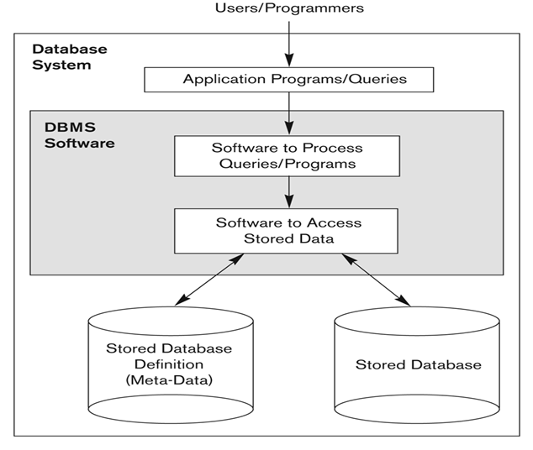
Database system environment
Figure 1.1 A simplified database system environment
Approved by AICTE |Affiliated to VTU | Recognized by UGC with 2(f) & 12(B) status |Accredited by NBA and NAAC

Slide 8
Typical DBMS Functionality
Define a particular database in terms of its data types, structures, and constraints
Construct or Load the initial database contents on a secondary storage medium
Manipulating the database:
  Retrieval: Querying, generating reports
  Modification: Insertions, deletions and updates to its content
  Accessing the database through Web applications
Processing and Sharing by a set of concurrent users and application programs – yet, keeping all data valid and consistent
Approved by AICTE |Affiliated to VTU | Recognized by UGC with 2(f) & 12(B) status |Accredited by NBA and NAAC

Slide 9
Typical DBMS Functionality
Other features:
  Protection or Security measures to prevent unauthorized access
  “Active” processing to take internal actions on data
  Presentation and Visualization of data
  Maintaining the database and associated programs over the lifetime of the database application
    Called database, software, and system maintenance
Approved by AICTE |Affiliated to VTU | Recognized by UGC with 2(f) & 12(B) status |Accredited by NBA and NAAC

Slide 10
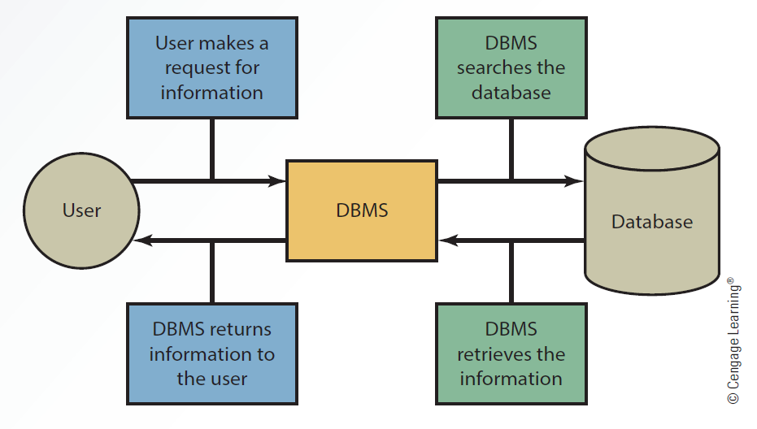
Interaction Between the User, DBMS and Database
Figure 1.2 :Interaction between the user, DBMS and Database
Figure Reference: www.csub.edu › ~ychoi2 › 4LTR_MIS6_Ch03
Approved by AICTE |Affiliated to VTU | Recognized by UGC with 2(f) & 12(B) status |Accredited by NBA and NAAC

Slide 11
Questions
------------------- is the collection of interrelated data and set of programs to access them.
Database Management system b) Database c)Data structure d)Database System
Ans: Database Management system
2. Which of the following is considered as DBMS?
Oracle b)Foxpro c)Access d)All of these
Ans: d)All of these
Approved by AICTE |Affiliated to VTU | Recognized by UGC with 2(f) & 12(B) status |Accredited by NBA and NAAC

Slide 12
Questions
3. The DBMS acts as an interface between what two components of an database system?
Database and user b)Database and SQL c)Data and Database d)Database Application and Database
Ans:d)Database Application and Database
Approved by AICTE |Affiliated to VTU | Recognized by UGC with 2(f) & 12(B) status |Accredited by NBA and NAAC

Slide 13
Recalling concepts
Definition of database, DBMS
Functionality of DBMS
Database system environment
Approved by AICTE |Affiliated to VTU | Recognized by UGC with 2(f) & 12(B) status |Accredited by NBA and NAAC

Slide 14
1.2 Example of a Database
Mini-world for example: Part of a UNIVERSITY environment.
Some mini-world entities:
  STUDENTs
  COURSEs
  SECTIONs (of COURSEs)
  (academic) DEPARTMENTs
  INSTRUCTORs
Some relationships:
  SECTIONs are of specific COURSEs
  STUDENTs take SECTIONs
  COURSEs have prerequisite COURSEs
  INSTRUCTORs teach SECTIONs
  COURSEs are offered by DEPARTMENTs
  STUDENTs major in DEPARTMENTs
Approved by AICTE |Affiliated to VTU | Recognized by UGC with 2(f) & 12(B) status |Accredited by NBA and NAAC

Slide 15
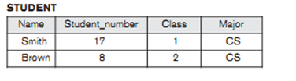

Figure 1.3 A database that stores student and course information
Approved by AICTE |Affiliated to VTU | Recognized by UGC with 2(f) & 12(B) status |Accredited by NBA and NAAC

Slide 16
1.3 Characteristics of the Database Approach
Self-describing nature of a database system
Insulation between programs and data
  program-data independence
  program-operation independence
Support of multiple views of the data
Sharing of data and multi-user transaction processing

Slide 17
1.3 Characteristics of the Database Approach
Self-describing nature of a database system:
In traditional file processing, data definition is typically part of the application programs themselves. Hence, these programs are constrained to work with only one specific database, whose structure is declared in the application programs.
  A DBMS catalog stores the description of a particular database (e.g. data structures, types, and constraints) called meta-data (data about data).
  This allows the DBMS software to work with different database applications.
2. Insulation between programs and data:
  In traditional file processing, the structure of data files is embedded in the application programs, so any changes to the structure of a file may require changing all programs that access that file.
  By contrast, DBMS access programs do not require such changes in most cases. The structure of data files is stored in the DBMS catalog separately from the access programs.Called program-data independence.
Approved by AICTE |Affiliated to VTU | Recognized by UGC with 2(f) & 12(B) status |Accredited by NBA and NAAC

Slide 18
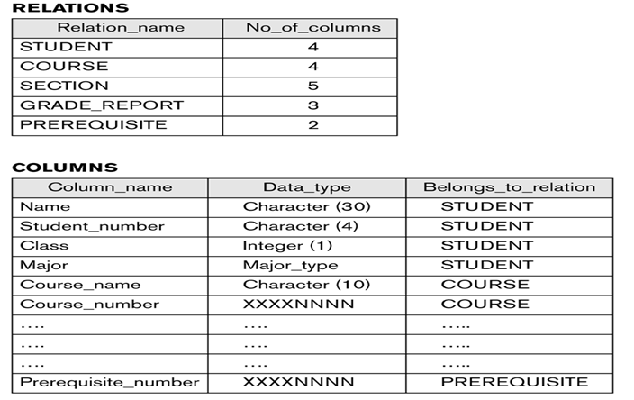
Example of a simplified database catalog
Figure 1.4 An example of a database catalog for the database
Approved by AICTE |Affiliated to VTU | Recognized by UGC with 2(f) & 12(B) status |Accredited by NBA and NAAC

Slide 19
Main Characteristics of the Database Approach (continued)
Users can define operations on data as part of the database definitions.
An operation (also called a function or method) is specified in two parts.
The interface (or signature) of an operation includes the operation name and the data types of its arguments (or parameters).
The implementation (or method) of the operation is specified separately and can be changed without affecting the interface.
User application programs can operate on the data by invoking these operations through their names and arguments, regardless of how the operations are implemented. This may be termed program-operation independence.
Data Abstraction:
  A data model is used to hide storage details and present the users with a conceptual view of the database.
Approved by AICTE |Affiliated to VTU | Recognized by UGC with 2(f) & 12(B) status |Accredited by NBA and NAAC

Slide 20
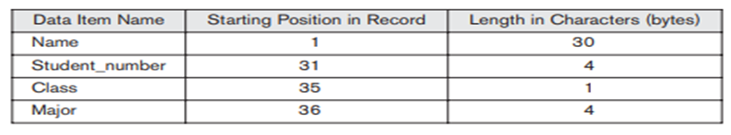
Main Characteristics of the Database Approach (continued)
  Programs refer to the data model constructs rather than data storage details
Figure 1.5 Internal storage format for a STUDENT record, based on the database catalog in figure 1.3
3. Support of multiple views of the data:
  Each user may see a different view of the database, which describes only the data of interest to that user.
Approved by AICTE |Affiliated to VTU | Recognized by UGC with 2(f) & 12(B) status |Accredited by NBA and NAAC

Slide 21
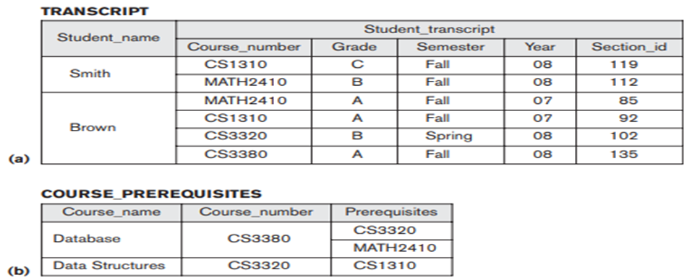
Main Characteristics of the Database Approach (continued)
Figure 1.6 Two views derived from the database in figure 1.2 .
a) The Transcript view b) The COURSE_PREREQUISITES view
Approved by AICTE |Affiliated to VTU | Recognized by UGC with 2(f) & 12(B) status |Accredited by NBA and NAAC

Slide 22
Main Characteristics of the Database Approach (continued)
4. Sharing of data and multi-user transaction processing:
  Allowing a set of concurrent users to retrieve from and to update the database.
  Concurrency control within the DBMS guarantees that each transaction is correctly executed or aborted
  Recovery subsystem ensures each completed transaction has its effect permanently recorded in the database
  OLTP (Online Transaction Processing) is a major part of database applications. This allows hundreds of concurrent transactions to execute per second.
Approved by AICTE |Affiliated to VTU | Recognized by UGC with 2(f) & 12(B) status |Accredited by NBA and NAAC

Slide 23
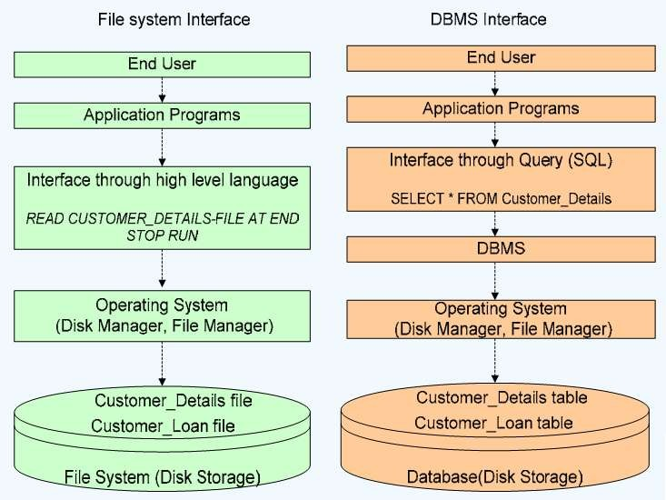
Difference Between File and DBMS Operations
Figure 1.7 Reference: https://www.slideshare.net/ravi_LCET
/relational-database-management-system-rdbms-i
Approved by AICTE |Affiliated to VTU | Recognized by UGC with 2(f) & 12(B) status |Accredited by NBA and NAAC

Slide 24
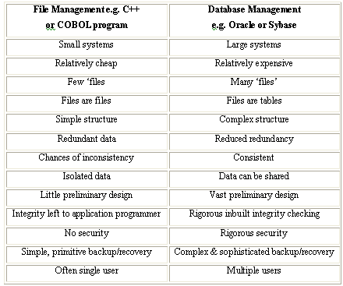
Difference between File system and DBMS
Table Reference:https://www.slideshare.net/ravi_LCET
/relational-database-management-system-rdbms-i
Approved by AICTE |Affiliated to VTU | Recognized by UGC with 2(f) & 12(B) status |Accredited by NBA and NAAC

Slide 25
Advantages of Using the Database Approach
1. Controlling Redundancy
2. Restricting unauthorized access to data
3. Providing persistent storage for program Objects and data structures
4. Providing Storage Structures and Search Techniques for Efficient Query Processing
5. Providing backup and recovery services:
6. Providing Multiple User Interfaces:
7. Enforcing Integrity Constraints

Slide 26
8. Enforcing Integrity Constraints
9. Permitting Inferencing and Actions Using Rules and Triggers
10. Additional Implications of Using the Database Approach
Potential for enforcing standards:DBA :Naming Convention
Reduced application development time:
Flexibility to change data structures:Change the structure of DB as requirement changes
Availability of current information: updated information to all
Economies of scale:

Slide 27
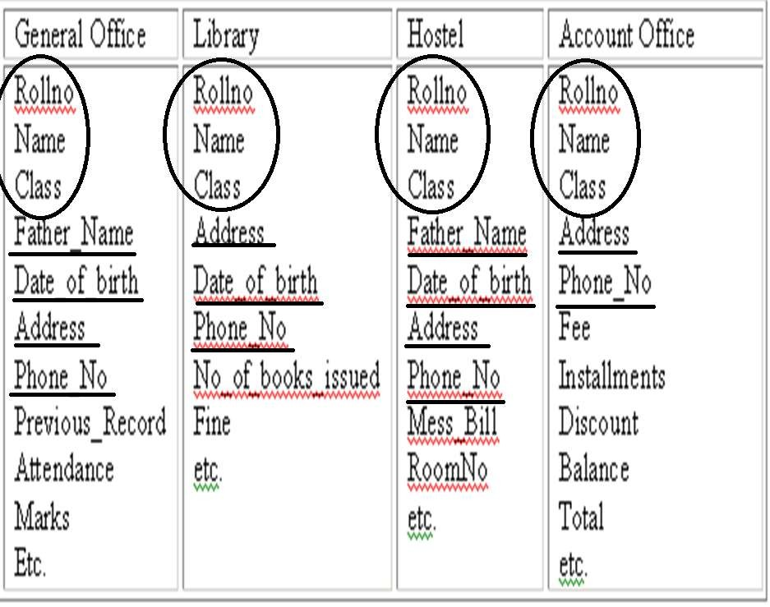
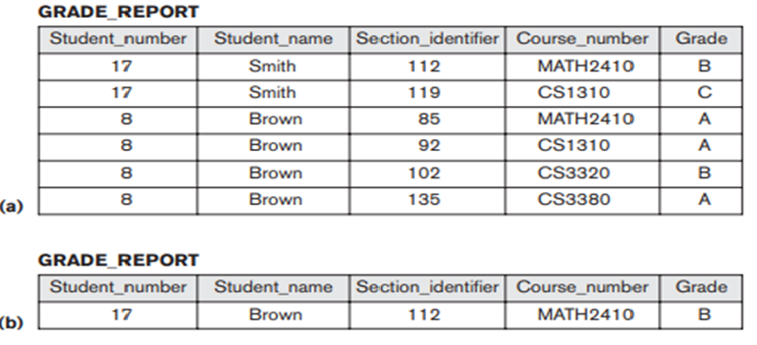
Advantages of Using the Database Approach
Controlling Redundancy
Figure 1.8 data Redundancy
Approved by AICTE |Affiliated to VTU | Recognized by UGC with 2(f) & 12(B) status |Accredited by NBA and NAAC

Slide 28
Advantages of Using the Database Approach
Redundancy in storing the same data multiple times leads to several problems.
There is the need to perform a single logical update—such as entering data on a new student—multiple times: once for each file where student data is recorded. This leads to duplication of effort.
storage space is wasted when the same data is stored repeatedly, and this problem may be serious for large databases
files that represent the same data may become inconsistent. This may happen because an update is applied to some of the files but not to others
Approved by AICTE |Affiliated to VTU | Recognized by UGC with 2(f) & 12(B) status |Accredited by NBA and NAAC

Slide 29
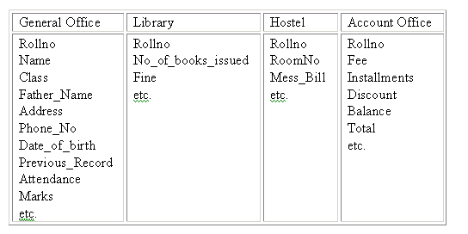
Advantages of Using the Database Approach continued
Figure 1.9 Redundancy control
In case of centralized database, data can be shared by number of applications
Every application can access the information of other’s by joining on the basis of column ( Rollno )
Approved by AICTE |Affiliated to VTU | Recognized by UGC with 2(f) & 12(B) status |Accredited by NBA and NAAC

Slide 30
Advantages of Using the Database Approach continued
Controlling redundancy in data storage and in development and maintenance efforts.
  Sharing of data among multiple users.
Figure 1.10 Redundant storage of Student_name in GRADE_REPORT. a) Consistant data b) Inconsistant data
Approved by AICTE |Affiliated to VTU | Recognized by UGC with 2(f) & 12(B) status |Accredited by NBA and NAAC

Slide 32
Figure 1.3 A database that stores student and course information
Approved by AICTE |Affiliated to VTU | Recognized by UGC with 2(f) & 12(B) status |Accredited by NBA and NAAC

Slide 33
Advantages of Using the Database Approach continued
2. Restricting unauthorized access to data:
When multiple users share a large database, it is likely that most users will not be authorized to access all information in the database. A DBMS should provide a security and authorization subsystem, which the DBA uses to create accounts and to specify account restrictions. Then, the DBMS should enforce these restrictions automatically.
3. Providing persistent storage for program Objects:
  Databases can be used to provide persistent storage for program objects and data structures. This is one of the main reasons for object-oriented database systems.
  Traditional database systems often suffered from the so called impedance mismatch problem, since the data structures provided by the DBMS were incompatible with the programming language’s data structures.
Approved by AICTE |Affiliated to VTU | Recognized by UGC with 2(f) & 12(B) status |Accredited by NBA and NAAC

Slide 34
Advantages of Using the Database Approach continued
4. Providing Storage Structures and Search Techniques for Efficient Query Processing:
Database systems must provide capabilities for efficiently executing queries and updates.
Auxiliary files called indexes are used for this purpose.
DBMS often has a buffering or caching module that maintains parts of the database in main memory buffers.
The query processing and optimization module of the DBMS is responsible for choosing an efficient query execution plan for each query based on the existing storage structures
Approved by AICTE |Affiliated to VTU | Recognized by UGC with 2(f) & 12(B) status |Accredited by NBA and NAAC

Slide 35
Advantages of Using the Database Approach continued
5. Providing backup and recovery services:
A DBMS must provide facilities for recovering from hardware or software failures.
The backup and recovery subsystem of the DBMS is responsible for recovery
6. Providing Multiple User Interfaces:
Interfaces include query languages for casual users, programming language interfaces for application programmers, forms and command codes for parametric users, and menu-driven interfaces and natural language interfaces for standalone users. Both forms-style interfaces and menu-driven interfaces are commonly known as graphical user interfaces (GUIs).
Approved by AICTE |Affiliated to VTU | Recognized by UGC with 2(f) & 12(B) status |Accredited by NBA and NAAC

Slide 36
Advantages of Using the Database Approach continued
7. Representing Complex Relationships among Data
A DBMS must have the capability to represent a variety of complex relationships among the data, to define new relationships as they arise, and to retrieve and update related data easily and efficiently
8. Enforcing Integrity Constraints
The simplest type of integrity constraint involves specifying a data type for each data item
A more complex type of constraint that frequently occurs involves specifying that a record in one file must be related to records in other files. This is known as a referential integrity constraint
Another type of constraint specifies uniqueness on data item values. This is known as a key or uniqueness constraint
Approved by AICTE |Affiliated to VTU | Recognized by UGC with 2(f) & 12(B) status |Accredited by NBA and NAAC

Slide 37
Advantages of Using the Database Approach continued
9. Permitting Inferencing and Actions Using Rules and Triggers
Some database systems provide capabilities for defining deduction rules for inferencing new information from the stored database facts. Such systems are called deductive database systems
10. Additional Implications of Using the Database Approach
Potential for enforcing standards:
  This is very crucial for the success of database applications in large organizations. Standards refer to data item names, display formats, screens, report structures, meta-data (description of data), Web page layouts, etc.
Reduced application development time:
  Incremental time to add each new application is reduced.
Flexibility to change data structures:
  Database structure may evolve as new requirements are defined
Approved by AICTE |Affiliated to VTU | Recognized by UGC with 2(f) & 12(B) status |Accredited by NBA and NAAC

Slide 38
Additional Implications of Using the Database Approach(continued)
Availability of current information:
  Extremely important for on-line transaction systems such as airline, hotel, car reservations.
Economies of scale:
  Wasteful overlap of resources and personnel can be avoided by consolidating data and applications across departments.
Approved by AICTE |Affiliated to VTU | Recognized by UGC with 2(f) & 12(B) status |Accredited by NBA and NAAC

Slide 39
A Brief History of Database Applications
Early Database Applications:
  The Hierarchical and Network Models were introduced in mid 1960s and dominated during the seventies.
  A bulk of the worldwide database processing still occurs using these models.
Relational Model based Systems:
  Relational model was originally introduced in 1970, was heavily researched and experimented with in IBM Research and several universities.
  Relational DBMS Products emerged in the 1980s.
Object-oriented and emerging applications:
  Object-Oriented Database Management Systems (OODBMSs) were introduced in late 1980s and early 1990s to cater to the need of complex data processing in CAD and other applications.
    Their use has not taken off much.
Approved by AICTE |Affiliated to VTU | Recognized by UGC with 2(f) & 12(B) status |Accredited by NBA and NAAC

Slide 40
A Brief History of Database Applications(continued)
  - Many relational DBMSs have incorporated object database concepts, leading to a new category called object-relational DBMSs (ORDBMSs)
  Extended relational systems add further capabilities (e.g. for multimedia data, XML, and other data types)
Data on the Web and E-commerce Applications:
  - Web contains data in HTML (Hypertext markup language) with links among pages.
  - This has given rise to a new set of applications and E-commerce is using new standards like XML (eXtended Markup Language).
  - Script programming languages such as PHP and JavaScript allow generation of dynamic Web pages that are partially generated from a database
    Also allow database updates through Web pages
Approved by AICTE |Affiliated to VTU | Recognized by UGC with 2(f) & 12(B) status |Accredited by NBA and NAAC

Slide 41
A Brief History of Database Applications(continued)
New functionality is being added to DBMSs in the following areas:
  - Scientific Applications
  - XML (eXtensible Markup Language)
  - Image Storage and Management
  - Audio and Video data management
  - Data Warehousing and Data Mining
  - Spatial data management
  - Time Series and Historical Data Management
Approved by AICTE |Affiliated to VTU | Recognized by UGC with 2(f) & 12(B) status |Accredited by NBA and NAAC

Slide 42
Questions
4. Before use of DBMS information was stored using ------------
File Management System b)Cloud system c)Data system d)All of These
Ans: File Management System
5. An advantage of the database management approach is
data is dependent on programs b)data redundancy increases
data is integrated and can be accessed by multiple programs d)none of the above
Ans: data is integrated and can be accessed by multiple programs
6. The characteristic that allows program-data independence and program-operation independence is called -----------------
a) Data manipulation b) Data Abstraction
c) Database System d) Database Management system
Ans: b) Data Abstraction
Approved by AICTE |Affiliated to VTU | Recognized by UGC with 2(f) & 12(B) status |Accredited by NBA and NAAC

Slide 43
Recalling concepts
Main Characteristics of the Database Approach
Difference between traditional file system and dbms
Advantages of Using the Database Approach
A Brief History of Database Applications
Approved by AICTE |Affiliated to VTU | Recognized by UGC with 2(f) & 12(B) status |Accredited by NBA and NAAC

Slide 44
Chapter-2
Database System Concepts and Architecture
2.1 Data Models, Schemas and Instances:
Data Model:
  A set of concepts to describe the structure of a database, the operations for manipulating these structures, and certain constraints that the database should obey.
Data Model Structure and Constraints:
  Constructs are used to define the database structure
  Constructs typically include elements (and their data types) as well as groups of elements (e.g entity, record, table), and relationships among such groups
  Constraints specify some restrictions on valid data; these constraints must be enforced at all times
Approved by AICTE |Affiliated to VTU | Recognized by UGC with 2(f) & 12(B) status |Accredited by NBA and NAAC

Slide 45
Data Model Operations:
  These operations are used for specifying database retrievals and updates by referring to the constructs of the data model.
  Operations on the data model may include basic model operations (e.g. generic insert, delete, update) and user-defined operations (e.g. compute_student_gpa, update_inventory)
Approved by AICTE |Affiliated to VTU | Recognized by UGC with 2(f) & 12(B) status |Accredited by NBA and NAAC

Slide 46
Categories of Data Models
Conceptual (high-level, semantic) data models:
  Provide concepts that are close to the way many users perceive data.
    (Also called entity-based or object-based data models.)
Physical (low-level, internal) data models:
  Provide concepts that describe details of how data is stored in the computer. These are usually specified in an ad-hoc manner through DBMS design and administration manuals
Implementation (representational) data models:
  Provide concepts that fall between the above two, used by many commercial DBMS implementations (e.g. relational data models used in many commercial systems).
Approved by AICTE |Affiliated to VTU | Recognized by UGC with 2(f) & 12(B) status |Accredited by NBA and NAAC

Slide 47
Schemas versus Instances
Database Schema:
  The description of a database.
  Includes descriptions of the database structure, data types, and the constraints on the database.
Schema Diagram:
  An illustrative display of (some aspects of) a database schema.
Schema Construct:
  A component of the schema or an object within the schema, e.g., STUDENT, COURSE.
Approved by AICTE |Affiliated to VTU | Recognized by UGC with 2(f) & 12(B) status |Accredited by NBA and NAAC

Slide 48
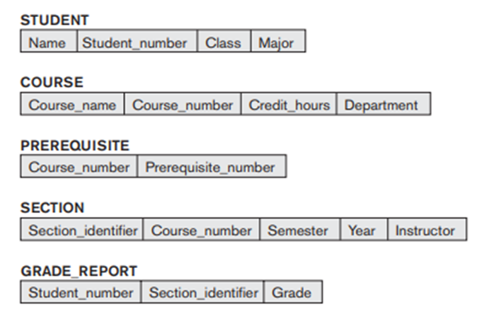
Example of a Database Schema
Figure 2.1 Schema Diagram for the database in figure 1.2
Approved by AICTE |Affiliated to VTU | Recognized by UGC with 2(f) & 12(B) status |Accredited by NBA and NAAC

Slide 49
Database State
Database State :
  The actual data stored in a database at a particular moment in time. This includes the collection of all the data in the database.
  Also called database instance (or occurrence or snapshot).
    The term instance is also applied to individual database components, e.g. record instance, table instance, entity instance
  Refers to the content of a database at a moment in time.
Initial Database State:
  Refers to the database state when it is initially loaded into the system.
Approved by AICTE |Affiliated to VTU | Recognized by UGC with 2(f) & 12(B) status |Accredited by NBA and NAAC

Slide 50
Valid State:
  A state that satisfies the structure and constraints of the database.
  The database schema changes very infrequently.
  The database state changes every time the database is updated.
Schema is also called intension.
State is also called extension.
Approved by AICTE |Affiliated to VTU | Recognized by UGC with 2(f) & 12(B) status |Accredited by NBA and NAAC

Slide 51
Example of a database state
Figure 2.2 A database that stores student and course information
Approved by AICTE |Affiliated to VTU | Recognized by UGC with 2(f) & 12(B) status |Accredited by NBA and NAAC

Slide 52
2.2 Three-Schema Architecture
Proposed to support DBMS characteristics of:
  Program-data independence.
  Support of multiple views of the data.
Not explicitly used in commercial DBMS products, but has been useful in explaining database system organization
Defines DBMS schemas at three levels:
  The internal level has an internal schema, which describes the physical storage structure of the database. The internal schema uses a physical data model and describes the complete details of data storage and access paths for the database
  Typically uses a physical data model
Approved by AICTE |Affiliated to VTU | Recognized by UGC with 2(f) & 12(B) status |Accredited by NBA and NAAC

Slide 53
Three-Schema Architecture continued
    2. The conceptual level has a conceptual schema, which describes the structure of the whole database for a community of users.
    The conceptual schema hides the details of physical storage structures and concentrates on describing entities, data types, relationships, user operations, and constraints.
    A representational data model is used to describe the conceptual schema when a database system is implemented.
    Uses a conceptual or an implementation data model.
  3. The external or view level includes a number of external schemas or user views. Each external schema describes the part of the database that a particular user group is interested in and hides the rest of the database from that user group.
  Usually uses the same data model as the conceptual level.
Approved by AICTE |Affiliated to VTU | Recognized by UGC with 2(f) & 12(B) status |Accredited by NBA and NAAC

Slide 54
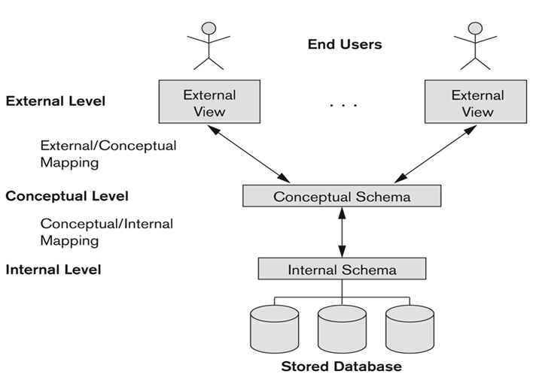
Three-Schema Architecture continued
Figure 2.3 The three schema architecture
Approved by AICTE |Affiliated to VTU | Recognized by UGC with 2(f) & 12(B) status |Accredited by NBA and NAAC

Slide 55
Three-Schema Architecture continued
Mappings among schema levels are needed to transform requests and data.
  Programs refer to an external schema, and are mapped by the DBMS to the internal schema for execution.
  Data extracted from the internal DBMS level is reformatted to match the user’s external view (e.g. formatting the results of an SQL query for display in a Web page)
Approved by AICTE |Affiliated to VTU | Recognized by UGC with 2(f) & 12(B) status |Accredited by NBA and NAAC

Slide 56




Example: University Database
External Schema (View 1 ):
External Schema (View 2):
Conceptual schema:
.
Physical schema:
Figure 2.4 Reference: https://www.slideshare.net/shubhamdwivedi3939/dbms-architecture
Course_info(cid:string,cname:string)
  student_info(cid:string, name:string)
Students(sid: string
name: string, login: string, age: integer)
Courses(cid: string,
cname:string,
credits:integer)
Enrolled(Eid:string,
cid:string, grade:string)
Relations stored as unordered files
Index on first column of students
Approved by AICTE |Affiliated to VTU | Recognized by UGC with 2(f) & 12(B) status |Accredited by NBA and NAAC

Slide 57
Data Independence
Logical Data Independence:
  The capacity to change the conceptual schema without having to change the external schemas and their associated application programs.
Physical Data Independence:
  The capacity to change the internal schema without having to change the conceptual schema.
  For example, the internal schema may be changed when certain file structures are reorganized or new indexes are created to improve database performance
When a schema at a lower level is changed, only the mappings between this schema and higher-level schemas need to be changed in a DBMS that fully supports data independence.
.
Approved by AICTE |Affiliated to VTU | Recognized by UGC with 2(f) & 12(B) status |Accredited by NBA and NAAC

Slide 58
Data Independence (continued)
The higher-level schemas themselves are unchanged.
  Hence, the application programs need not be changed since they refer to the external schemas
Approved by AICTE |Affiliated to VTU | Recognized by UGC with 2(f) & 12(B) status |Accredited by NBA and NAAC

Slide 59
Questions
8. Entity-Relationship model is a popular ----------------
a) high-level conceptual data model b) Low level physical data model
c) Low level conceptual data model d)High level physical model
Ans: high-level conceptual data model
9. The data in the database at a particular moment in time is called a
Database state b)Snapshot
Valid state d)Both a and b
Ans: d)Both a and b
Approved by AICTE |Affiliated to VTU | Recognized by UGC with 2(f) & 12(B) status |Accredited by NBA and NAAC

Slide 60
Questions
10. -----------describes the physical storage structure of the database.
internal schema b)conceptual schema c) external schema d)All of the above
Ans: internal schema
11. Data independence means
data is defined separately and not included in programs.
programs are not dependent on the physical attributes of data
programs are not dependent on the logical attributes of data
both B and C
Ans: both B and C
12. Which database level is closest to the users?
External b) Internal c) Physical d) Conceptual
Ans: External
Approved by AICTE |Affiliated to VTU | Recognized by UGC with 2(f) & 12(B) status |Accredited by NBA and NAAC

Slide 61
Recalling concepts
Definition of Instances, schemas, data models
Categories of data models
Three schema architecture
Data independence
Approved by AICTE |Affiliated to VTU | Recognized by UGC with 2(f) & 12(B) status |Accredited by NBA and NAAC

Slide 62
2.3 DBMS Languages
Data Definition Language (DDL):
  Used by the DBA and database designers to specify the conceptual schema of a database.
  In many DBMSs, the DDL is also used to define internal and external schemas (views).
  In some DBMSs, separate storage definition language (SDL) and view definition language (VDL) are used to define internal and external schemas.
    SDL is typically realized via DBMS commands provided to the DBA and database designers
Data Manipulation Language (DML)
  High-Level or Non-procedural Languages: These include the relational language SQL
    May be used in a standalone way or may be embedded in a programming language
Approved by AICTE |Affiliated to VTU | Recognized by UGC with 2(f) & 12(B) status |Accredited by NBA and NAAC

Slide 63
  Low Level or Procedural Languages:
    These must be embedded in a programming language
  Used to specify database retrievals and updates
  DML commands (data sublanguage) can be embedded in a general-purpose programming language (host language), such as COBOL, C, C++, or Java.
    A library of functions can also be provided to access the DBMS from a programming language
  Alternatively, stand-alone DML commands can be applied directly (called a query language).
Storage definition language (SDL)
  Specifies the internal schema
View definition language (VDL)
  Specifies user views/mappings to conceptual schema
Approved by AICTE |Affiliated to VTU | Recognized by UGC with 2(f) & 12(B) status |Accredited by NBA and NAAC

Slide 64
DBMS Languages
Data Definition Language (DDL)
Data Manipulation Language (DML)
  High-Level or Non-procedural Languages: These include the relational language SQL
    May be used in a standalone way or may be embedded in a programming language
  Low Level or Procedural Languages:
    These must be embedded in a programming language

Slide 65
DBMS Languages
Data Definition Language (DDL):
  Used by the DBA and database designers to specify the conceptual schema of a database.
  In many DBMSs, the DDL is also used to define internal and external schemas (views).
  In some DBMSs, separate storage definition language (SDL) and view definition language (VDL) are used to define internal and external schemas.
    SDL is typically realized via DBMS commands provided to the DBA and database designers

Slide 66
DBMS Languages
Data Manipulation Language (DML):
  Used to specify database retrievals and updates
  DML commands (data sublanguage) can be embedded in a general-purpose programming language (host language), such as COBOL, C, C++, or Java.
    A library of functions can also be provided to access the DBMS from a programming language
  Alternatively, stand-alone DML commands can be applied directly (called a query language).

Slide 67
Types of DML
High Level or Non-procedural Language:
  For example, the SQL relational language
  Are “set”-oriented and specify what data to retrieve rather than how to retrieve it.
  Also called declarative languages.
Low Level or Procedural Language:
  Retrieve data one record-at-a-time;
  Constructs such as looping are needed to retrieve multiple records, along with positioning pointers.

Slide 68
DBMS Interfaces
Stand-alone query language interfaces
  Example: Entering SQL queries at the DBMS interactive SQL interface (e.g. SQL*Plus in ORACLE)
Programmer interfaces for embedding DML in programming languages
User-friendly interfaces
  Menu-based, forms-based, graphics-based, etc.
Programmer interfaces for embedding DML in a programming languages:
  Embedded Approach: e.g embedded SQL (for C, C++, etc.), SQLJ (for Java)
Approved by AICTE |Affiliated to VTU | Recognized by UGC with 2(f) & 12(B) status |Accredited by NBA and NAAC

Slide 69
DBMS Interfaces(Continued)
  Procedure Call Approach: e.g. JDBC for Java, ODBC for other programming languages
  Database Programming Language Approach: e.g. ORACLE has PL/SQL, a programming language based on SQL; language incorporates SQL and its data types as integral components
  Menu-based, popular for browsing on the web
  Forms-based, designed for naïve users
  Graphics-based
    (Point and Click, Drag and Drop, etc.)
  Natural language: requests in written English
  Combinations of the above:
    For example, both menus and forms used extensively in Web database interfaces
Approved by AICTE |Affiliated to VTU | Recognized by UGC with 2(f) & 12(B) status |Accredited by NBA and NAAC

Slide 70
DBMS Interfaces(Continued)
  Speech as Input and Output
  Web Browser as an interface
  Parametric interfaces, e.g., bank tellers using function keys.
  Interfaces for the DBA:
    Creating user accounts, granting authorizations
    Setting system parameters
    Changing schemas or access paths
Approved by AICTE |Affiliated to VTU | Recognized by UGC with 2(f) & 12(B) status |Accredited by NBA and NAAC

Slide 71
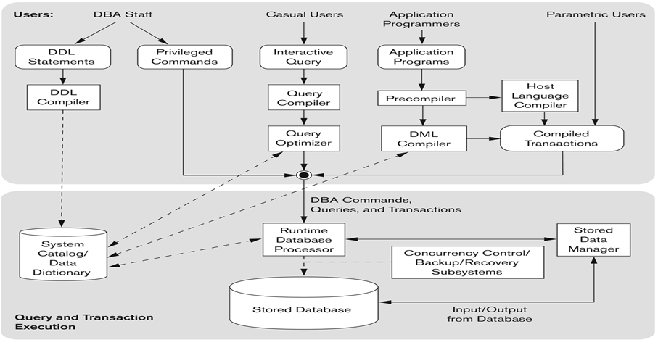
2.4 Database System Environment-DBMS Component Modules
Figure 2.5 Component modules of a DBMS and their interaction
Approved by AICTE |Affiliated to VTU | Recognized by UGC with 2(f) & 12(B) status |Accredited by NBA and NAAC

Slide 72
The DBMS system structure is divided into two component modules.
  Upper module - different users of the database environment and their interfaces.
  Lower module - internals of the DBMS responsible for storage of data and processing of transaction.
UPPER Module
  DBA staff
    Defines the database and makes changes to its description using the DDL and other privileged commands.
    The DBMS catalog stores the description of the schemas that are processed by the DLL compilers.
    The catalog includes names and sizes of the files, data types, storage details of each file, mapping information among schemas and constraints.
Approved by AICTE |Affiliated to VTU | Recognized by UGC with 2(f) & 12(B) status |Accredited by NBA and NAAC

Slide 73
  Casual users (persons with occasional need)
    Utilize menu based or form based query interfaces.
    The query compiler parses the queries, analysis the data elements for its correctness and converts it into internal form.
    The internal query is passed through the query optimizer for rearrangement of operations and elimination of redundancies.
Application programmer
  Writes programs in host languages.
  The precompiler separates the DML command and the host program.
  DML commands are submitted to the DML compiler and the rest of the program to the host compiler.
  The outputs of DML compiler and host compiler are linked by the compiled transaction to form the executable codes which includes the calls to the runtime database processor.
Approved by AICTE |Affiliated to VTU | Recognized by UGC with 2(f) & 12(B) status |Accredited by NBA and NAAC

Slide 74
Parametric users
  Supply the parameters (eg. account number and amount for bank withdrawal) using the compiled transactions.
The privileged commands, executable query plan and the compiled transactions with the runtime parameters are executed by the runtime database processor. It refers the data dictionary for updations.
LOWER module
  Stored data manager carry out the input and output operations between the disk and main memory and provides support for database management including management of access paths and indexes.
Approved by AICTE |Affiliated to VTU | Recognized by UGC with 2(f) & 12(B) status |Accredited by NBA and NAAC

Slide 75
  The file manager deals with the data structure options for storing in the database and maintains the metadata as well as indexes for various files.
  The interfacing between the main memory and disk is handled by the buffer manager.
  The transaction manager is responsible for concurrency and crash recovery by maintaining a record of all changes to the database.
Approved by AICTE |Affiliated to VTU | Recognized by UGC with 2(f) & 12(B) status |Accredited by NBA and NAAC

Slide 76
Database System Utilities
To perform certain functions such as:
  Loading data stored in files into a database. Includes data conversion tools.
  Backing up the database periodically on tape.
  Reorganizing database file structures.
  Report generation utilities.
  Performance monitoring utilities.
  Other functions, such as sorting, user monitoring, data compression, etc.
Approved by AICTE |Affiliated to VTU | Recognized by UGC with 2(f) & 12(B) status |Accredited by NBA and NAAC

Slide 77
Other Tools
Data dictionary / repository:
  Used to store schema descriptions and other information such as design decisions, application program descriptions, user information, usage standards, etc.
  Active data dictionary is accessed by DBMS software and users/DBA.
  Passive data dictionary is accessed by users/DBA only.
Application Development Environments and CASE (computer-aided software engineering) tools:
Examples:
  PowerBuilder (Sybase)
  JBuilder (Borland)
  JDeveloper 10G (Oracle)
Approved by AICTE |Affiliated to VTU | Recognized by UGC with 2(f) & 12(B) status |Accredited by NBA and NAAC

Slide 78
Questions
13. The database schema is written in --------
VDL b)DML c) DDL d) DCL
Ans: DDL
14. Data Manipulation Language is used for ---------
Insert information into the database b) Retrieve information from the database
c) Delete information d) All of these
Ans: All of these
Approved by AICTE |Affiliated to VTU | Recognized by UGC with 2(f) & 12(B) status |Accredited by NBA and NAAC

Slide 79
Questions
15. Set of definitions that are used to specify schema are expressed using
DDL b) Java c) Fortran d)DML
Ans: DDL
16. Result of compilation of DDL statement is stored in special file called as ------------
Database Schema File b) Database File
c) Symbol Table d) Data dictionary
Ans: Data dictionary
Approved by AICTE |Affiliated to VTU | Recognized by UGC with 2(f) & 12(B) status |Accredited by NBA and NAAC

Slide 80
Questions
17. There are ------------ types of DML
1 b) 2 c) 3 d) 4
Ans: 2
18. -------------interfaces accept requests written in English or some other language and attempt to understand them.
Menu based interfaces b) Form based interfaces
Natural Language interfaces d)Graphical User Interfaces
Ans: Natural Language interfaces
Approved by AICTE |Affiliated to VTU | Recognized by UGC with 2(f) & 12(B) status |Accredited by NBA and NAAC

Slide 81
Conceptual Modeling
Important phase in designing a successful database application.
Database application refers to a particular database and the associated programs that implement the database queries and updates.
Eg. Bank Application
The modeling concepts of the entity–relationship (ER) model, which is a popular high-level conceptual data model.
Need to learn the diagrammatic notation associated with the ER model, known as ER diagrams.

Slide 82
MCQs
A data model is
Used to describe structure of database b)Set of basic operations on the database
c) Both a and b d)None of these
Answer: Option c
2) The layer which deals with user interaction is called _____________ layer.
a) Business logic b) Presentation c) User interaction d) Data access
Answer: option b
3) The _____________ layer, which provides a high-level view of data and actions on data.
a) Business logic b) Presentation c) User interaction d) Data access
Answer: option A

Slide 83
4. Collection of information stored in a database at a particular moment is called…………
View b)Schema c) Instance d) None of these
Answer: option c)instance
5. The syntax of a user query is verified by………..
Query optimizer b)DBA c)Parser d)None of these
Answer: Option c)Parser/Query Compiler

Slide 84
Recalling concepts
DBMS Languages
DBMS Interfaces
Database System Environment-DBMS Component Modules
Database System utilities
Centralized and Client/Server Architectures
Approved by AICTE |Affiliated to VTU | Recognized by UGC with 2(f) & 12(B) status |Accredited by NBA and NAAC

Slide 85
Chapter-3
Conceptual Data Modelling using Entities and Relationships
Example - COMPANY Database:
We need to create a database schema design based on the following (simplified) requirements of the COMPANY Database:
  The company is organized into DEPARTMENTs. Each department has a name, number and an employee who manages the department. We keep track of the start date of the department manager. A department may have several locations.
  Each department controls a number of PROJECTs. Each project has a unique name, unique number and is located at a single location.
  We store each EMPLOYEE’s social security number, address, salary, sex, and birthdate.
    Each employee works for one department but may work on several projects.
Approved by AICTE |Affiliated to VTU | Recognized by UGC with 2(f) & 12(B) status |Accredited by NBA and NAAC

Slide 86
Example COMPANY Database (Contd.)
    We keep track of the number of hours per week that an employee currently works on each project.
    We also keep track of the direct supervisor of each employee
  Each employee may have a number of DEPENDENTs.
    For each dependent, we keep track of their name, sex, birthdate, and relationship to the employee.
Approved by AICTE |Affiliated to VTU | Recognized by UGC with 2(f) & 12(B) status |Accredited by NBA and NAAC

Slide 87
Entity types, Entity sets, attributes and keys
Entities and Attributes
  Entities are specific objects or things in the mini-world that are represented in the database.
    For example the EMPLOYEE John Smith, the Research DEPARTMENT, the ProductX PROJECT
    Collection of entities of a particular entity type in a database at any point of time is called entity set
    Entity type:
    Entity type is represented as rectangle enclosing the type name which is singular noun.
STUDENT
Approved by AICTE |Affiliated to VTU | Recognized by UGC with 2(f) & 12(B) status |Accredited by NBA and NAAC

Slide 88
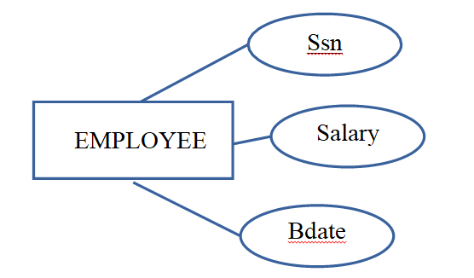
  Attributes are properties used to describe an entity.
Attribute names are enclosed by ovals and connected to their entities by single line
    For example an EMPLOYEE entity may have the attributes Name, SSN, Address, Sex, BirthDate
  A specific entity will have a value for each of its attributes.
    For example a specific employee entity may have Name='John Smith', SSN='123456789', Address ='731, Fondren, Houston, TX', Sex='M', BirthDate='09-JAN-55‘
  Each attribute has a value set (or data type) associated with it – e.g. integer, string, subrange, enumerated type, …
Approved by AICTE |Affiliated to VTU | Recognized by UGC with 2(f) & 12(B) status |Accredited by NBA and NAAC

Slide 89
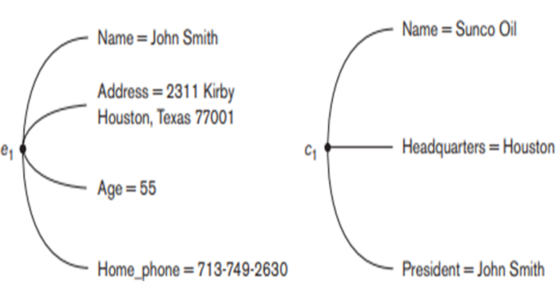
Figure 3.1 Two entities , EMPLOYEE e1, and COMPANY c1, and their attributes
Approved by AICTE |Affiliated to VTU | Recognized by UGC with 2(f) & 12(B) status |Accredited by NBA and NAAC

Slide 90
Types of Attributes
Simple vs Composite
Single valued vs Multi valued
Stored vs Derived
Null values and Complex Attributes

Slide 91
Types of Attributes
Simple Attribute
  Each entity has a single atomic value for the attribute. For example, SSN or Sex.
Composite Attribute
  The attribute may be composed of several components. For example:
    Address(Apt#, House#, Street, City, State, ZipCode, Country), or
    Name(FirstName, MiddleName, LastName).
    Composition may form a hierarchy where some components are themselves composite.
Single-valued Attribute
  Most attributes have a single value for a particular entity; such attributes are called single-valued.
  For example, Age is a single-valued attribute of a person.
Approved by AICTE |Affiliated to VTU | Recognized by UGC with 2(f) & 12(B) status |Accredited by NBA and NAAC

Slide 92
Types of Attributes (continued)
Multi-valued Attribute
  An entity may have multiple values for that attribute. For example, Color of a CAR or Previous Degrees of a STUDENT.
    Denoted as {Color} or {Previous Degrees}.
    Another example Hobbies-drawing, stamp collection….
In general, composite and multi-valued attributes may be nested arbitrarily to any number of levels, although this is rare.
  For example, Previous Degrees of a STUDENT is a composite multi-valued attribute denoted by {Previous Degrees (College, Year, Degree, Field)}
  Multiple Previous Degrees values can exist
  Each has four subcomponent attributes:
    College, Year, Degree, Field
Approved by AICTE |Affiliated to VTU | Recognized by UGC with 2(f) & 12(B) status |Accredited by NBA and NAAC

Slide 93
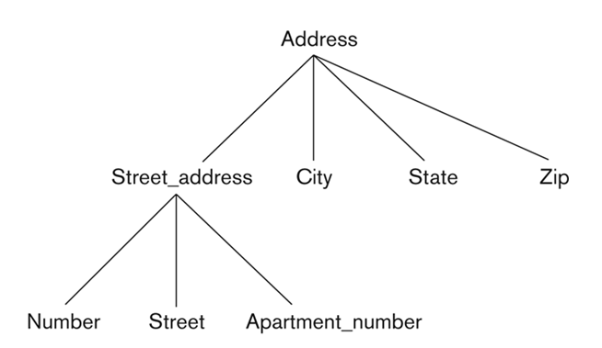
Example of a composite attribute
Figure 3.2 A hierarchy of composite attributes
Approved by AICTE |Affiliated to VTU | Recognized by UGC with 2(f) & 12(B) status |Accredited by NBA and NAAC

Slide 94
Simple versus composite attibute
  SIMPLE ATTRIBUTE
SIMPLE ATTRIBUTE
COMPOSITE ATTRIBUTE
  Cannot be split in to further attributes(indivisible)
  Also known as Atomic
  attribute
  Ex: Ssn(Social Security
  Number)
Can be divided in to smaller subparts which represent more basic attributes with independent meaning
Even form hierarchy
Value of the composite attribute is the composition of the constituent simple attributes
Ex: Address
Approved by AICTE |Affiliated to VTU | Recognized by UGC with 2(f) & 12(B) status |Accredited by NBA and NAAC

Slide 95
Single valued vs. multi valued attribute
SINGLE VALUED ATTRIBUTE
MULTI VALUED ATTRIBUTE
Attribute having set of values
Attributes having single value for particular entity.
Ex - Age
Denoted by double circled oval
Ex: Phone-number, College- degree
Approved by AICTE |Affiliated to VTU | Recognized by UGC with 2(f) & 12(B) status |Accredited by NBA and NAAC

Slide 96
Types of Attributes (continued)
Stored versus Derived Attributes:
In some cases, two (or more) attribute values are related—for example, the Age and Birth_date attributes of a person.
For a particular person entity, the value of Age can be determined from the current (today’s) date and the value of that person’s Birth_date. The Age attribute is hence called a derived attribute and is said to be derivable from the Birth_date attribute, which is called a stored attribute.
Some attribute values can be derived from related entities; for example, an attribute Number_of_employees of a DEPARTMENT entity can be derived by counting the number of employees related to (working for) that department.
Approved by AICTE |Affiliated to VTU | Recognized by UGC with 2(f) & 12(B) status |Accredited by NBA and NAAC

Slide 97
Derived Versus stored attribute
DERIVED ATTRIBUTE
Attribute values are derived from another attribute.
STORED ATTRIBUTE
Attributes from which the values of other attributes are derived
Denoted by dotted oval
Ex - Age
Ex: Bdate
Approved by AICTE |Affiliated to VTU | Recognized by UGC with 2(f) & 12(B) status |Accredited by NBA and NAAC

Slide 98
Types of Attributes (continued)
NULL Values:
In some cases, a particular entity may not have an applicable value for an attribute.
For example, the Apartment_number attribute of an address applies only to addresses that are in apartment buildings and not to other types of residences, such as single-family homes.
Similarly, a College_degrees attribute applies only to people with college degrees. For such situations, a special value called NULL is created. An address of a single-family home would have NULL for its Apartment_number attribute, and a person with no college degree would have NULL for College_degrees.
NULL can also be used if we do not know the value of an attribute for a particular entity—for example, if we do not know the home phone number of ‘John Smith’
Approved by AICTE |Affiliated to VTU | Recognized by UGC with 2(f) & 12(B) status |Accredited by NBA and NAAC

Slide 99
Types of Attributes (continued..)
Complex Attributes:
In general, composite and multivalued attributes can be nested arbitrarily. We can represent arbitrary nesting by grouping components of a composite attribute between parentheses () and separating the components with commas, and by displaying multivalued attributes between braces { }. Such attributes are called complex attributes.
For example, if a person can have more than one residence and each residence can have a single address and multiple phones, Both Phone and Address are themselves composite attributes.
Figure 3.3 A complex attribute: Address_phone
Approved by AICTE |Affiliated to VTU | Recognized by UGC with 2(f) & 12(B) status |Accredited by NBA and NAAC

Slide 100
Entity Types and Entity Sets.
An entity type defines a collection (or set) of entities that have the same attributes. Each entity type in the database is described by its name and attributes.
The collection of all entities of a particular entity type in the database at any point in time is called an entity set; the entity set is usually referred to using the same name as the entity type.
For example, EMPLOYEE refers to both a type of entity as well as the current set of all employee entities in the database.
An entity type describes the schema or intension for a set of entities that share the same structure. The collection of entities of a particular entity type is grouped into an entity set, which is also called the extension of the entity type.
Approved by AICTE |Affiliated to VTU | Recognized by UGC with 2(f) & 12(B) status |Accredited by NBA and NAAC

Slide 101
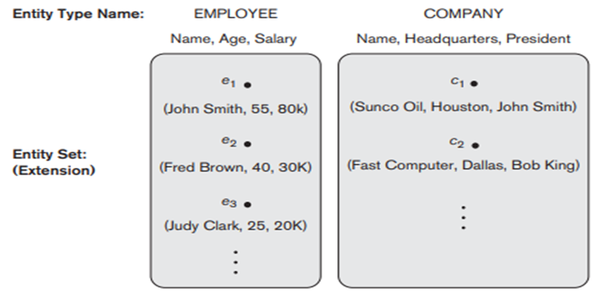
Entity Types and Entity Sets continued
Figure 3.4 Two entity types, EMPLOYEE and COMPANY ,and some member entities of each
Approved by AICTE |Affiliated to VTU | Recognized by UGC with 2(f) & 12(B) status |Accredited by NBA and NAAC

Slide 102
Key Attributes of an Entity Type.
An important constraint on the entities of an entity type is the key or uniqueness constraint on attributes.
An entity type usually has one or more attributes whose values are distinct for each individual entity in the entity set. Such an attribute is called a key attribute, and its values can be used to identify each entity uniquely.
For example, the Name attribute is a key of the COMPANY entity type because no two companies are allowed to have the same name.
For the PERSON entity type, a typical key attribute is Ssn (Social Security number).
In ER diagrammatic notation, each key attribute has its name underlined inside the oval, as illustrated in Figure 3.5 (a).
Domain – the set of permitted values for each attribute
Approved by AICTE |Affiliated to VTU | Recognized by UGC with 2(f) & 12(B) status |Accredited by NBA and NAAC

Slide 103
Displaying an Entity type
In ER diagrams, an entity type is displayed in a rectangular box
Attributes are displayed in ovals
Each attribute is connected to its entity type
Components of a composite attribute are connected to the oval representing the composite attribute
Each key attribute is underlined
Multivalued attributes displayed in double ovals

Slide 104
Draw an ER Diagram Representation for car
Entity Type: Car
Attributes:
  Registration number Composite(state, registration)……>key
  Vehicle id ----------→key
  Year
  Make
  Model
  Color ----------→multivalued

Slide 105
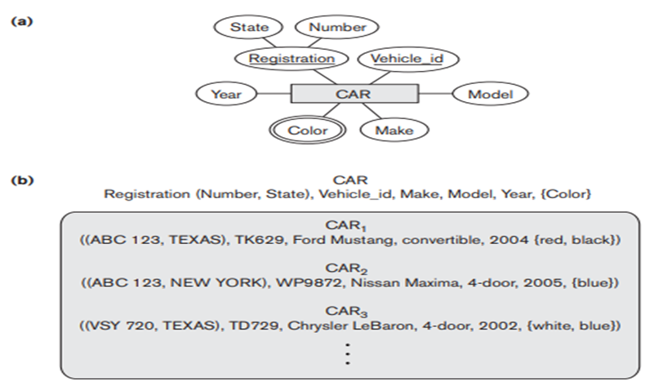
Figure 3.5 The CAR entity type with two key attributes, Registration and Vehicle_id
a) ER diagram notation b) Entity set with three attributes
Approved by AICTE |Affiliated to VTU | Recognized by UGC with 2(f) & 12(B) status |Accredited by NBA and NAAC

Slide 106
Questions
19. The attributes that can be arranged into hierarchy are called -----------
Composite attribute b)Atomic attributes c)Derived attributes d)Simple attributes
Ans: Composite attribute
20. Set of all entities having same attributes is called classified as--------
Entity type b) Attribute type c) Function type d)Hierarchy type
Ans: Entity type
21. In a database schema, the database snapshot is also called
Current set of entity b) Current set of instances
c) Current set of attributes d) Current set of objects
Ans: Current set of instances
Approved by AICTE |Affiliated to VTU | Recognized by UGC with 2(f) & 12(B) status |Accredited by NBA and NAAC

Slide 107
Recalling concepts
Entity types, Entity sets, attributes and keys
Types of attributes
Key Attributes of an Entity Type.
Approved by AICTE |Affiliated to VTU | Recognized by UGC with 2(f) & 12(B) status |Accredited by NBA and NAAC

Slide 108
Example - COMPANY Database:
We need to create a database schema design based on the following (simplified) requirements of the COMPANY Database:
  The company is organized into DEPARTMENTs. Each department has a name, number and an employee who manages the department. We keep track of the start date of the department manager. A department may have several locations.
  Each department controls a number of PROJECTs. Each project has a unique name, unique number and is located at a single location.
  We store each EMPLOYEE’s social security number, address, salary, sex, and birthdate.
    Each employee works for one department but may work on several projects.
Approved by AICTE |Affiliated to VTU | Recognized by UGC with 2(f) & 12(B) status |Accredited by NBA and NAAC

Slide 109
Example COMPANY Database (Contd.)
    We keep track of the number of hours per week that an employee currently works on each project.
    We also keep track of the direct supervisor of each employee
  Each employee may have a number of DEPENDENTs.
    For each dependent, we keep track of their name, sex, birthdate, and relationship to the employee.
Approved by AICTE |Affiliated to VTU | Recognized by UGC with 2(f) & 12(B) status |Accredited by NBA and NAAC

Slide 110
Initial Design of Entity Types for the COMPANY Database Schema
Based on the requirements, we can identify four initial entity types in the COMPANY database:
DEPARTMENT
PROJECT
EMPLOYEE
DEPENDENT

Slide 111
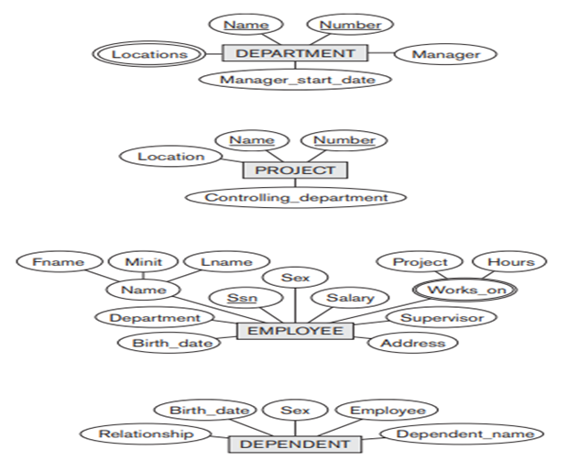
Department
An entity type DEPARTMENT with attributes Name, Number, Locations, Manager, and Manager_start_date. Locations is the only multivalued attribute. We can specify that both Name and Number are (separate) key attributes because each was specified to be unique.

Slide 112
PROJECT
An entity type PROJECT with attributes Name, Number, Location, and Controlling_department. Both Name and Number are (separate) key attributes.

Slide 113
EMPLOYEE
An entity type EMPLOYEE with attributes Name, Ssn, Sex, Address, Salary, Birth_date, Department, and Supervisor. Both Name and Address may be composite attributes; however, this was not specified in the requirements. We must go back to the users to see if any of them will refer to the individual components of Name—First_name, Middle_initial, Last_name—or of Address.

Slide 114
Initial Design of Entity Types for the COMPANY Database Schema
An entity type DEPENDENT with attributes Employee, Dependent_name, Sex, Birth_date, and Relationship (to the employee).
Approved by AICTE |Affiliated to VTU | Recognized by UGC with 2(f) & 12(B) status |Accredited by NBA and NAAC

Slide 115
Initial Design of Entity Types:
EMPLOYEE, DEPARTMENT, PROJECT, DEPENDENT
Figure 3.6 Preliminary design of entity types for the COMPANY database.
Some of the shown attributes will be refined into relationships
Approved by AICTE |Affiliated to VTU | Recognized by UGC with 2(f) & 12(B) status |Accredited by NBA and NAAC

Slide 116
Questions
1. The attributes that can be arranged into hierarchy are called -----------
Composite attribute b)Atomic attributes c)Derived attributes d)Simple attributes
Ans: Composite attribute
2. Set of all entities having same attributes is called classified as--------
Entity type b) Attribute type c) Function type d)Hierarchy type
Ans: Entity type
Approved by AICTE |Affiliated to VTU | Recognized by UGC with 2(f) & 12(B) status |Accredited by NBA and NAAC

Slide 117
Refining the initial design by introducing relationships
The initial design is typically not complete
Some aspects in the requirements will be represented as relationships
ER model has three main concepts:
  Entities (and their entity types and entity sets)
  Attributes (simple, composite, multivalued)
  Relationships (and their relationship types and relationship sets)
We introduce relationship concepts next
Approved by AICTE |Affiliated to VTU | Recognized by UGC with 2(f) & 12(B) status |Accredited by NBA and NAAC

Slide 118
Relationships and Relationship Types
A relationship relates two or more distinct entities with a specific meaning
.
  For example, EMPLOYEE John Smith works on the ProductX PROJECT, or EMPLOYEE Franklin Wong manages the Research DEPARTMENT.
Relationships of the same type are grouped or typed into a relationship type.
  For example, the WORKS_ON relationship type in which EMPLOYEEs and PROJECTs participate, or the MANAGES relationship type in which EMPLOYEEs and DEPARTMENTs participate.
The degree of a relationship type is the number of participating entity types.
  Both MANAGES and WORKS_ON are binary relationships.
Approved by AICTE |Affiliated to VTU | Recognized by UGC with 2(f) & 12(B) status |Accredited by NBA and NAAC

Slide 119
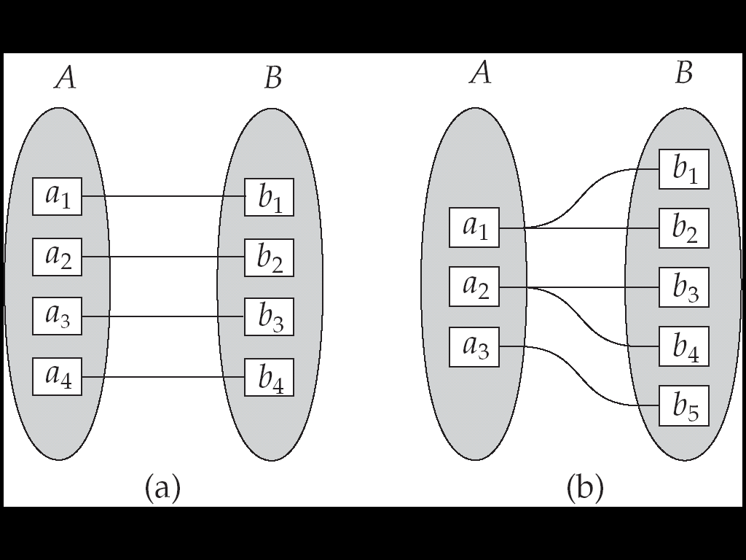
Mapping Cardinality Constraints
For a binary relationship set the mapping cardinality must be one of the following types:
  One to one
  One to many
  Many to one
  Many to many
Figure 3.7 Cardinality mapping : a) One to one b) One to many
Approved by AICTE |Affiliated to VTU | Recognized by UGC with 2(f) & 12(B) status |Accredited by NBA and NAAC

Slide 120
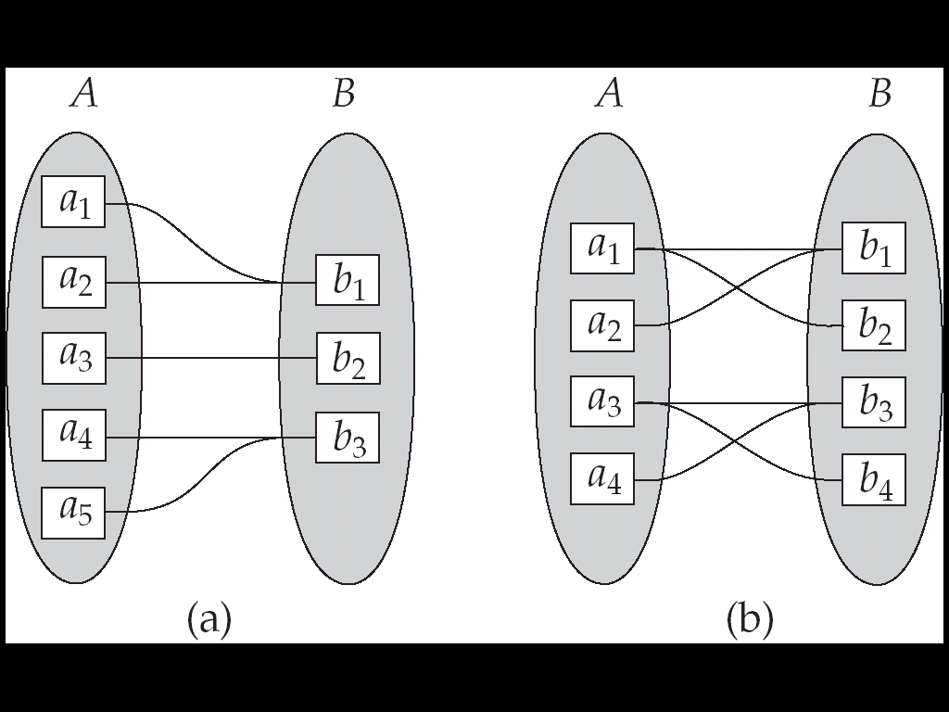
Mapping Cardinalities
Figure 3.8 Cardinality mapping : a) Many to one b) Many to many
Approved by AICTE |Affiliated to VTU | Recognized by UGC with 2(f) & 12(B) status |Accredited by NBA and NAAC

Slide 121
Relationship type vs. relationship set
Relationship Type:
  Is the schema description of a relationship
  Identifies the relationship name and the participating entity types
  Also identifies certain relationship constraints
Relationship Set:
  The current set of relationship instances represented in the database
  The current state of a relationship type
Each instance in the set relates individual participating entities – one from each participating entity type
In ER diagrams, we represent the relationship type as follows:
  Diamond-shaped box is used to display a relationship type Connected to the participating entity types via straight lines
Approved by AICTE |Affiliated to VTU | Recognized by UGC with 2(f) & 12(B) status |Accredited by NBA and NAAC

Slide 122
Constraints on Relationships
Cardinality Ratio and Participation Constraint together form Structural Constraints
Constraints on Relationship Types
  (Also known as ratio constraints)
  Cardinality Ratio (specifies maximum participation)
    One-to-one (1:1)
    One-to-many (1:N) or Many-to-one (N:1)
    Many-to-many (M:N)
  Existence Dependency Constraint (specifies minimum participation) (also called participation constraint)
    zero (optional participation, not existence-dependent) PARTIAL
    one or more (mandatory participation, existence-dependent) TOTAL
Approved by AICTE |Affiliated to VTU | Recognized by UGC with 2(f) & 12(B) status |Accredited by NBA and NAAC

Slide 123
Notation for Constraints on Relationships
Cardinality ratio (of a binary relationship): 1:1, 1:N, N:1, or M:N
  Shown by placing appropriate numbers on the relationship edges.
Participation constraint (on each participating entity type): total (called existence dependency) or partial.
  Total shown by double line, partial by single line.
Approved by AICTE |Affiliated to VTU | Recognized by UGC with 2(f) & 12(B) status |Accredited by NBA and NAAC

Slide 124
Refining the COMPANY database schema by introducing relationships
By examining the requirements, six relationship types are identified
All are binary relationships( degree 2)
Listed below with their participating entity types:
  WORKS_FOR (between EMPLOYEE, DEPARTMENT)
  MANAGES (also between EMPLOYEE, DEPARTMENT)
  CONTROLS (between DEPARTMENT, PROJECT)
  WORKS_ON (between EMPLOYEE, PROJECT)
  SUPERVISION (between EMPLOYEE (as subordinate), EMPLOYEE (as supervisor))
  DEPENDENTS_OF (between DEPENDENT, EMPLOYEE)
Approved by AICTE |Affiliated to VTU | Recognized by UGC with 2(f) & 12(B) status |Accredited by NBA and NAAC

Slide 125
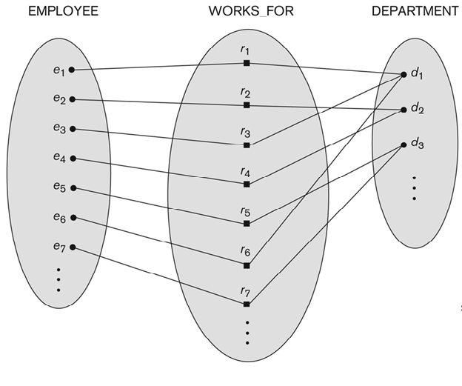
Relationship instances of the WORKS_FOR between EMPLOYEE and DEPARTMENT
Figure 3.9 Some instances in the WORKS_FOR relationship set, which represents a
relationship type WORKS_FOR between EMPLOYEE and the DEPARTMENT
N:1 relationship
Approved by AICTE |Affiliated to VTU | Recognized by UGC with 2(f) & 12(B) status |Accredited by NBA and NAAC

Slide 126
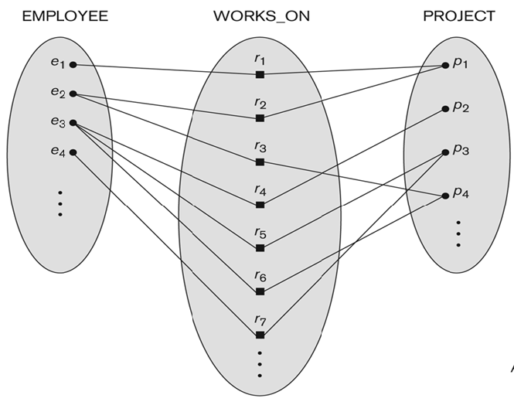
Relationship instances of WORKS_ON relationship between EMPLOYEE and PROJECT
Figure 3.10 An M:N relationship, WORKS_ON
M:N Relationship
Approved by AICTE |Affiliated to VTU | Recognized by UGC with 2(f) & 12(B) status |Accredited by NBA and NAAC

Slide 127
Manages (an employee manages a department)
Employee Manages Department
1:1 Relation

Slide 128
CONTROLS (between DEPARTMENT, PROJECT)
1: N relationship
Department Controls Project

Slide 129
Recursive Relationship Type
An relationship type whose with the same participating entity type in distinct roles
Example: the SUPERVISION relationship
EMPLOYEE participates twice in two distinct roles:
  supervisor (or boss) role
  supervisee (or subordinate) role
Each relationship instance relates two distinct EMPLOYEE entities:
  One employee in supervisor role
  One employee in supervisee role
Approved by AICTE |Affiliated to VTU | Recognized by UGC with 2(f) & 12(B) status |Accredited by NBA and NAAC

Slide 130
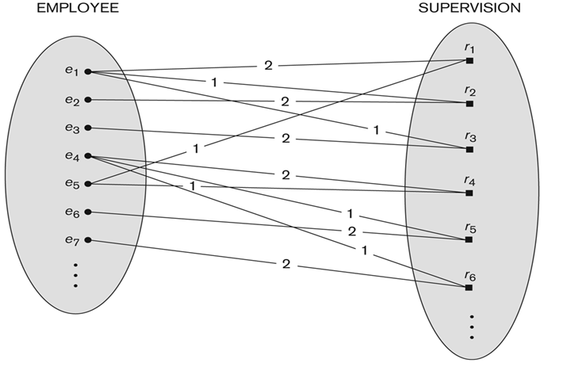
A Recursive Relationship Supervision
Figure 3.13 A recursive relationship SUPERVISION between EMPLOYEE
in the supervisor role (1) and EMPLOYEE in the subordinate role (2)
Approved by AICTE |Affiliated to VTU | Recognized by UGC with 2(f) & 12(B) status |Accredited by NBA and NAAC

Slide 131
Weak Entity Types
An entity that does not have a key attribute
A weak entity must participate in an identifying relationship type with an owner or identifying entity type
Entities are identified by the combination of:
  A partial key of the weak entity type
  The particular entity they are related to the identifying entity type/owner entity type
Example:
  A DEPENDENT entity is identified by the dependent’s first name, and the specific EMPLOYEE with whom the dependent is related
  Name of DEPENDENT is the partial key
  DEPENDENT is a weak entity type
  EMPLOYEE is its identifying entity type via the identifying relationship type DEPENDENT_OF
Approved by AICTE |Affiliated to VTU | Recognized by UGC with 2(f) & 12(B) status |Accredited by NBA and NAAC

Slide 132
DEPENDENTS_OF - Identifying Relation
DEPENDENTS_OF, a 1:N relationship type between EMPLOYEE and DEPENDENT, which is also the identifying relationship for the weak entity type DEPENDENT.
The participation of EMPLOYEE is partial, whereas that of DEPENDENT is total

Slide 133
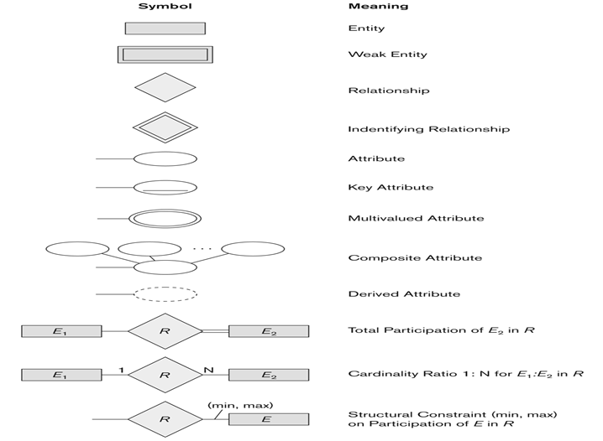
Summary of notation for ER diagrams
Figure 3.14 Summary of the notation for ER diagram
Approved by AICTE |Affiliated to VTU | Recognized by UGC with 2(f) & 12(B) status |Accredited by NBA and NAAC

Slide 134
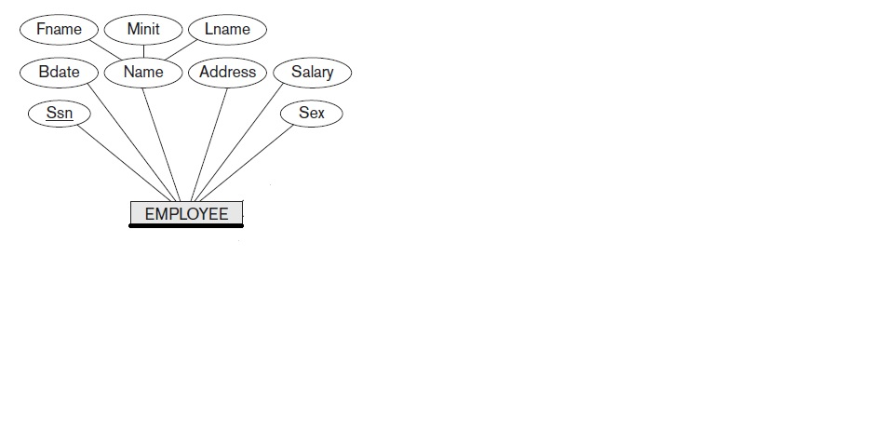
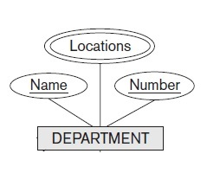
Works_For
Works_For
1
N

Slide 135
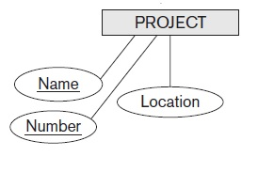
Works_on
Hours
M
Works_on
N

Slide 136
Manages
Manages
1
1
Start_Date

Slide 137
CONTROLS
CONTROLS
N
1

Slide 138
SUPERVISION
SUBORDINATE
SUPERVISOR
1
SUPERVISION
N

Slide 139
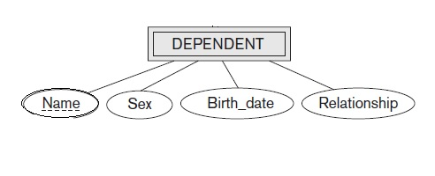
DEPENDENT_OF
1
N
DEPENDENT_OF

Slide 140
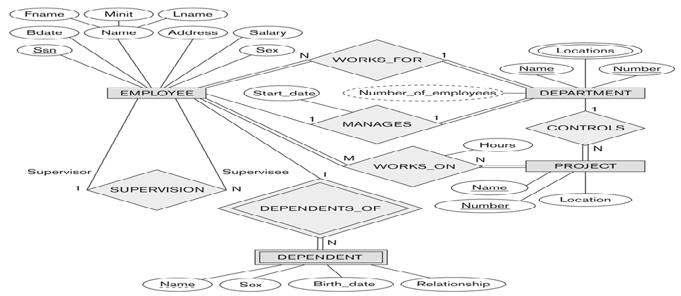
ER DIAGRAM – Relationship Types are: WORKS_FOR, MANAGES, WORKS_ON, CONTROLS, SUPERVISION, DEPENDENTS_OF
Figure 3.11 An ER diagram for the COMPANY database.
Approved by AICTE |Affiliated to VTU | Recognized by UGC with 2(f) & 12(B) status |Accredited by NBA and NAAC

Slide 141
Discussion on Relationship Types
In the refined design, some attributes from the initial entity types are refined into relationships:
  Manager of DEPARTMENT -> MANAGES
  Works_on of EMPLOYEE -> WORKS_ON
  Department of EMPLOYEE -> WORKS_FOR
  etc
In general, more than one relationship type can exist between the same participating entity types
  MANAGES and WORKS_FOR are distinct relationship types between EMPLOYEE and DEPARTMENT
  Different meanings and different relationship instances.
Approved by AICTE |Affiliated to VTU | Recognized by UGC with 2(f) & 12(B) status |Accredited by NBA and NAAC

Slide 142
Questions
22. A ………………. does not have a distinguishing attribute if its own and most are dependent entities, which are part of some another entity.
Weak entity b) Strong entity c) Non-attributes entity d)Dependent entity
Ans: Weak entity
23. The number of tuples in a relation is called its …………. While the number of entities in a relation is called it’s ………………..
Degree, Cardinality b) Cardinality, Degree c) Rows, Columns d) Columns, Rows
Ans: b) Cardinality, Degree
Approved by AICTE |Affiliated to VTU | Recognized by UGC with 2(f) & 12(B) status |Accredited by NBA and NAAC

Slide 143
Questions
24. Which are the two ways in which entities can participate in a relationship?
Passive and active
Total and partial
Simple and Complex
All of the above
Ans: Total and partial
25. In a one-to-many relationship, the entity that is on the one side of the relationship is called ________ entity.
Parent b) child c)instance d) subtype
Ans: Parent
Approved by AICTE |Affiliated to VTU | Recognized by UGC with 2(f) & 12(B) status |Accredited by NBA and NAAC

Slide 144
Recalling concepts
Relationships
Constraints
Mapping
Recursive relationship
ER diagram
Approved by AICTE |Affiliated to VTU | Recognized by UGC with 2(f) & 12(B) status |Accredited by NBA and NAAC

Slide 145
Example
Assume we have the following application that models cricket teams, capture the following information in the ER- Diagram
We have a set of teams, each team has an ID, name, stadium, and to which country this team belongs.
Each team has many players, and each player belongs to one team. Each player has a number, name, DoB, start year, and jersey number that he uses.
Teams play matches, in each match there is a host team and a guest team. The match takes place in the stadium of the host team.
For each match we need to keep track of the following:
  The date on which the match is played
  The final result of the match
  The players participated in the match. For each player, how many runs he scored, whether or not he took wickets, and whether or not he scored 100’s.
Each match has exactly three umpires. For each umpire we have an ID, name, DoB, years of experience. Two umpires are main and the other one is the third umpire.
Approved by AICTE |Affiliated to VTU | Recognized by UGC with 2(f) & 12(B) status |Accredited by NBA and NAAC

Slide 146
Example #2
Company stores information on its shipped item. The requirements are as follows
Shipped items can be characterized by item number (unique), weight, insurance amount, destination and delivery date. Shipped items are received at a single trade center.
Trade centers are characterized by their type, ID, and address. Shipped items are dispatched via one or more standard transportation.
These transportation are characterized by a unique schedule Number, mode (e.g, airways, waterways, roadways), and a delivery Route.
Create an E-R diagram that captures this information.
Approved by AICTE |Affiliated to VTU | Recognized by UGC with 2(f) & 12(B) status |Accredited by NBA and NAAC

Slide 147
Case study #1
Draw a complete ER diagram for the following scenario.
The COMPANY database keeps track of a company’s employees, departments and projects.
The company is organized into departments. Each department has a unique name, an unique number and a particular employee who manages the department.
A department controls a number of projects, each of which has a unique name, unique number and a single location.
We store each employee’s name, SSN, address, salary, gender and birth date. An employee is assigned to one department, but may work on several projects, which are not necessarily controlled by the same department. We keep track of the number hours per week that an employee works on each project.
Approved by AICTE |Affiliated to VTU | Recognized by UGC with 2(f) & 12(B) status |Accredited by NBA and NAAC

Slide 148
Case study #2
Consider a MOVIE database in which data is recorded . Draw an ER diagram for the following requirements
Each movie is identified by title and year of release. Each movie has a length in minutes one or more genres (such as horror, action, drama,…). Each movie has one or more directors and one or more actors appear in it. Each movie also has a plot outline. Finally, each movie has zero or more quotable quotes, each of which is spoken by a particular actor appearing in the movie.
Actors are identified by name and date of birth and appear in one or more movie. Each actor has a role in the movie.
Directors are also identified by name and date of birth and direct one or more movies. It is possible for a director to act in a movie (including one that he or she may also direct).
Production companies are identified by name and each has an address. A production company produces one or more movies.
Approved by AICTE |Affiliated to VTU | Recognized by UGC with 2(f) & 12(B) status |Accredited by NBA and NAAC

Slide 149
Case study #3
Draw an ER diagram to represent the Election Information System based on the following descriptions:
In the Indian national election, a state is divided into a number of constituencies depending upon the population of the state .Several candidates contest elections in each constituency. Candidates may be from some party or independent. The election information system must record the number of votes obtained by each candidate. The system also maintains the voter list and a voter normally belongs to a particular constituency.
Note that the party details must also be taken care in the design.
Approved by AICTE |Affiliated to VTU | Recognized by UGC with 2(f) & 12(B) status |Accredited by NBA and NAAC

Slide 150
References
For figures and content:
Fundamentals of Database Systems, Ramez Elmasri and Shamkant B. Navathe, 7th Edition, 2017, Pearson.
NPTEL video:
2.http://www.infocobuild.com/education/audio-video-courses/computer-science/DatabaseManagementSystem-IIT-Kharagpur/lecture-14.html
Innovative content link:
Architecture of a database system by Joseph M. Hellerstein, Michael Stonebraker and James Hamilton
https://dsf.berkeley.edu/papers/fntdb07-architecture.pdf
http://vlabs.iitkgp.ernet.in/se/4/simulation/ (Virtual lab-ER diagram)
http://www.rebellionrider.com/category/pl-sql/
https://www.lucidchart.com/pages/templates/er-diagram
Approved by AICTE |Affiliated to VTU | Recognized by UGC with 2(f) & 12(B) status |Accredited by NBA and NAAC

Slide 151
THANK YOU
Approved by AICTE |Affiliated to VTU | Recognized by UGC with 2(f) & 12(B) status |Accredited by NBA and NAAC

